Slide 1
GOOGLE EARTH ENGINE AND GITHUB BASICS Ernest Opoku-Kwarteng eopoku-kwarteng@ug.edu.gh Center for Remote Sensing and Geographic Information Services (CERSGIS)
Accra, Ghana
September, 2021

Slide 2
Introduction to JavaScript

Slide 3
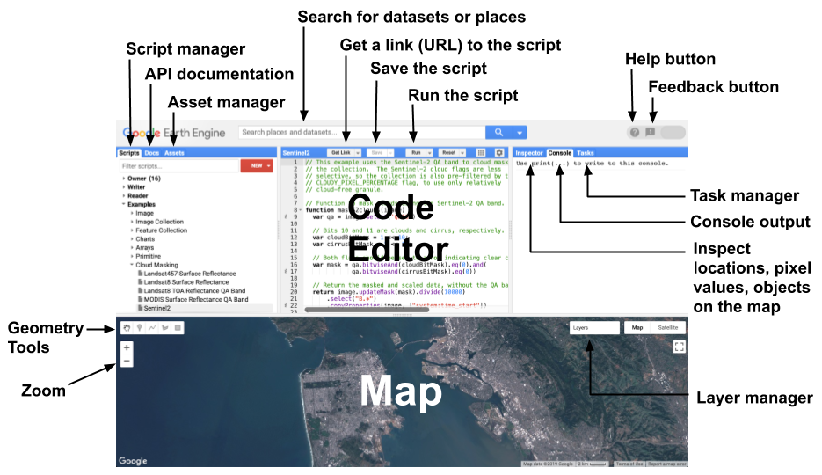
This introduction covers getting started with JavaScript
GEE is built on JavaScript API and Python API
The code editor is the interface to interact with the JavaScript API
https://code.earthengine.google.com/

Slide 4
Coding in JavaScript
Learning by doing
Go to code.earthengine.google.com and copy the following into the Code Editor and click on run
print('Hello World!’);
// print('Hello World!’);
print (’This is my first JavaScript code’)
Run in Code Editor

Slide 5
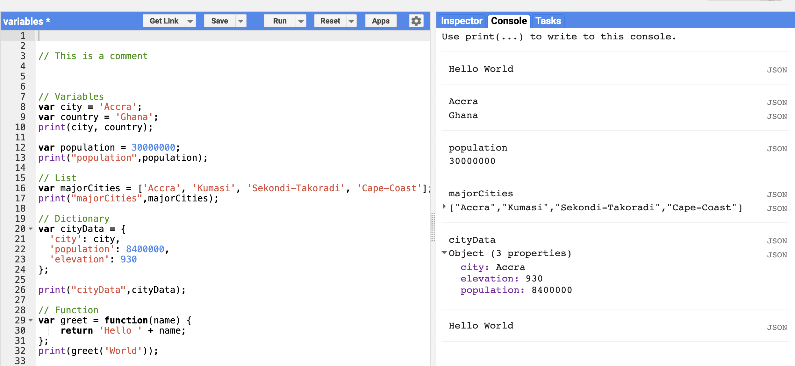
Variables
Variables are containers for storing elements.In Javascrript a variable is declared using the keyword var
Varibles can store strings, numbers, lists, tuples ….
Example
var school = “University of Ghana“
var year = [2015,2016,2017,2018]
var a = 23
var b = 11
var c = a + b
print ( c )
print(school)
Run in Code Editor

Slide 6
OPERATIONAL SYMBOLS IN JAVASCRIPT
OPERATOR | DESCRIPTION
Modulus (%) | Returns the integer remainder of dividing the two operands.
Add (+) | Returns the sum of numeric operands or string concatenation.
Multiply (*) | Produces the product of the operands.
Subtract (-) | subtracts the two operands, producing their difference.
Exponent (**) | Returns the result of raising the first operand to the power of the second operand. It is equivalent to Math.pow
Division ( / ) | Produce the quotient of its operands where the left operand is the dividend and the right operand is the divisor.
And (&&) | for a set of operands is true if and only if all of its operands are true.
Not (!) | takes truth to falsity and vice versa
If then else (? :) | Conditional statement

Slide 7
OPERATIONAL SYMBOLS
OPERATOR | DESCRIPTION
Equal (==) | Returns true if the operands are equal.
Not equal (!=) | Returns true if the operands are not equal.
Greater than (>) | Returns true if the left operand is greater than the right operand.
Greater than or equal (>=) | Returns true if the left operand is greater than or equal to the right operand.
Less than (<) | Returns true if the left operand is less than the right operand.
Less than or equal (<=) | Returns true if the left operand is less than or equal to the right operand.
Or (||) | for a set of operands is true if and only if one or more of its operands is true.

Slide 8
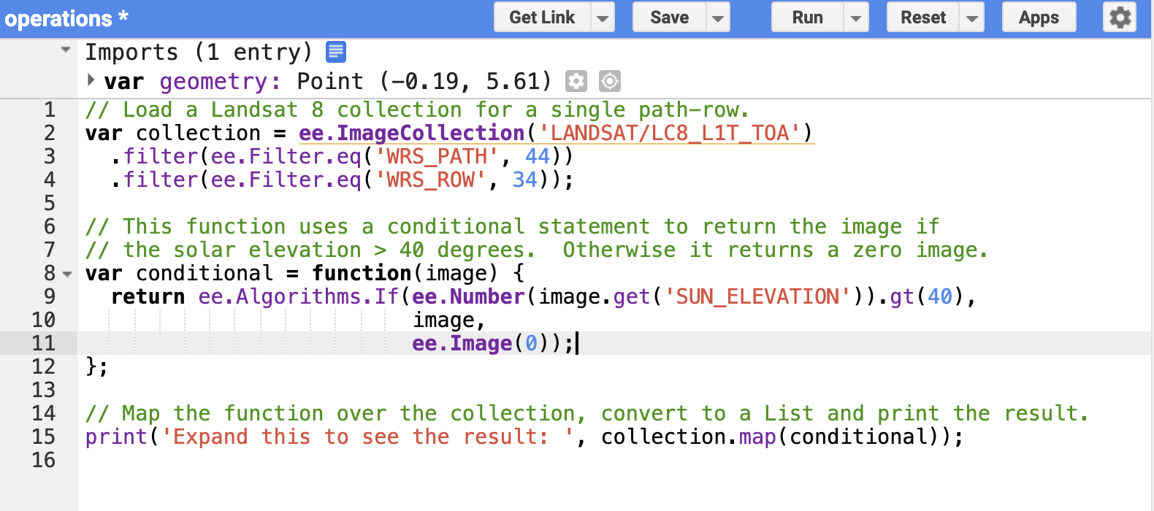
Comparison Operators
OPERATOR | DESCRIPTION
eq() | Equal to
gt() | greater than
gte() | greater than or equal
lt() | less than
lte() | less than or equal
Run in Code Editor

Slide 9
MATH OBJECTS
Math.random(); // returns a random number
Math.min(0, 150, 30, 20, -8); // returns -8
Math.round(4.7); // returns 5
Math.round(4.4); // returns 4
Math.ceil(4.4); // returns 5
Math.floor(4.4); // returns 4
Math.E; // returns Euler's number
Math.PI // returns PI
Math.SQRT2 // returns the square root of 2 Math.
SQRT1_2 // returns the square root of 1/2
Math.LN2 // returns the natural logarithm of 2
Math.LN10 // returns the natural logarithm of 10
Math.LOG2E // returns base 2 logarithm of E
Math.LOG10E // returns base 10 logarithm of E

Slide 10
BASIC JavaScript DATA TYPES
Strings
Numbers
Lists
Dictionary
Objects
Functions

Slide 11
JavaScript / GEE DATA TYPES
Strings
Using variables to store objects and primitives helps code readability
A variable that stores a string object is defined by single ' or double " quotes
Do not mix single ' and double " quotes – be consistent
Example
Make a new string and store it in a variable called greetString:
// Use single (or double) quotes to make a string. var greetString = 'Ahoy there!’;
var greetString2 = "Ahoy there!";
// Use parentheses to pass arguments to functions. print(greetString);
print(greetString2);

Slide 12
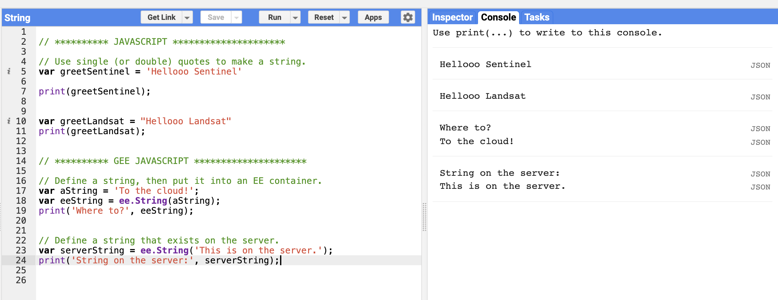
String(GEE)
// Define a string, then put it into an EE container. var aString = 'To the cloud!'; var eeString = ee.String(aString); print('Where to?', eeString);
Think of ee.Thing as a container for a thing that exists on the server. In the following example, the string is defined first, then placed in the container. You can also define the container and its contents all at once
Example
// Define a string that exists on the server. var serverString = ee.String('This is on the server.'); print('String on the server:', serverString);
Run in Code Editor

Slide 13
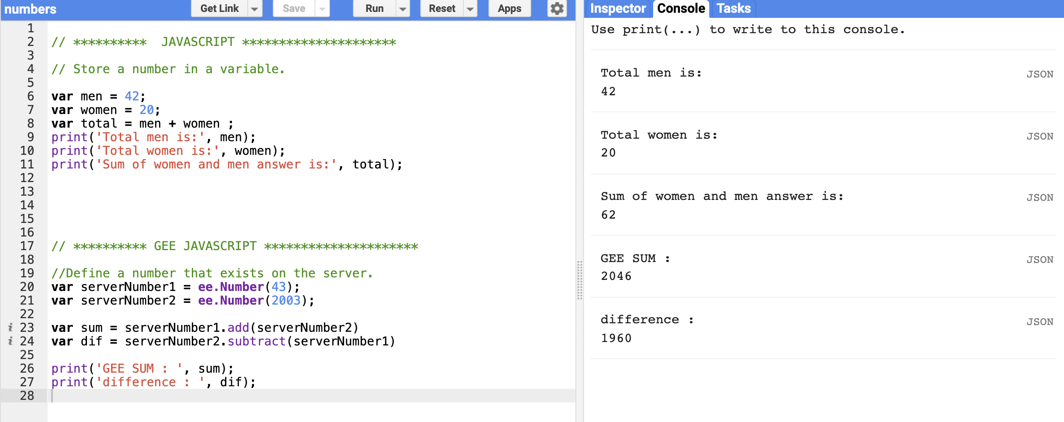
Numbers
Variables can also store numbers
Example
// Store a number in a variable. var men = 42;
var women = 20;
var total = men + women;
print(‘Total men is:', men);
print(‘Total women is:', women);
print(‘Sum of women and men answer is:', total);

Slide 14
Number(GEE)
Use ee.Number() to create number objects on the server
Use the Math.E JavaScript method to create a constant value on the server
// Define a number that exists on the server. var serverNumber = ee.Number(Math.E); print('e=', serverNumber);
The ee.String() and ee.Number() methods are constructors
A constructor takes its argument (and possibly other parameters), puts it in a container, and returns the container and its contents as an Earth Engine object that can be manipulated in a code.
Any constructor starting with ee returns an Earth Engine object.

Slide 15
List
A list is defined with square brackets []
List of numbers, for example:
// Use square brackets [] to make a list. var listOfNumbers = [0, 1, 1, 2, 3, 5]; print('List of numbers:', listOfNumbers);
Lists can also store strings or other objects
// Make a list of strings. var listOfStrings = ['a', 'b', 'c', 'd']; print('List of strings:', listOfStrings);

Slide 16
Lists (GEE)
To make a JavaScript list into an ee.List object on the server, put a JavaScript literal into a container as with numbers and strings
Earth Engine also provides server-side convenience methods for making sequences of numbers
// Make a sequence the hard way. var eeList = ee.List([1, 2, 3, 4, 5]); // Make a sequence the easy way! var sequence = ee.List.sequence(1, 5); print('Sequence:', sequence);
Since the ee.List objects only exist on the server, use Earth Engine provided functions to interact with them
Use the get() method to get element(s) out of the list, of ee.List objects
// Use a method on an ee.List to extract a value. var value = sequence.get(2); print('Value at index 2:', value);
Run in Code Editor
Run in Code Editor

Slide 17
Objects(Dictionary)
Objects in JavaScript are dictionaries of key value pairs
Object (or dictionary) are created with curly brackets {}
// Use curly brackets {} to make a dictionary of key:value pairs.
var object = {
foo: 'bar',
baz: 13,
stuff: ['this', 'that', 'the other thing']
};
print('Dictionary:', object);
// Access dictionary items using square brackets.
print('Print foo:', object['foo']);
// Access dictionary items using dot notation.
print('Print stuff:', object.stuff);

Slide 18
Dictionary (GEE)
An Earth Engine Dictionary can be constructed from a JavaScript object, as with strings, numbers and lists
During the construction, JavaScript functionality can be used to initialize the Earth Engine object. In the following example an ee.Dictionary is constructed directly from a JavaScript literal object:
// Make a Dictionary on the server. var dictionary = ee.Dictionary({ e: Math.E, pi: Math.PI, phi: (1 + Math.sqrt(5)) / 2 }); // Get some values from the dictionary. print('Euler:', dictionary.get('e')); print('Pi:', dictionary.get('pi')); print('Golden ratio:', dictionary.get('phi')); // Get all the keys: print('Keys: ', dictionary.keys());
Run in Code Editor

Slide 19
DIFFERENCE BETWEEN LIST AND DICTIONARY
LIST | DICTIONARY
List is a collection of index values pairs | Dictionary is a hashed structure of key and value pairs.
List is created by placing elements in [ ] separated by commas “, “ | Dictionary is created by placing elements in { } as “key”:”value”, each key value pair is separated by commas “, “
The indices of list are integers starting from 0. | The keys of dictionary can be of any data type.
The elements are accessed via indices. | The elements are accessed via key-values.
The order of the elements entered are maintained. | There is no guarantee for maintaining order.

Slide 20
Dates
Date objects represents time Earth Engine
As in the previous examples, it is important to distinguish between a JavaScript Date object and an Earth Engine ee.Dateobject
Construct an ee.Date from a string, from a JavaScript Date, or using static methods provided by the ee.Date class. (see the Date section in the Docs tab for details)
// Define a date in Earth Engine. var date = ee.Date('2015-12-31'); print('Date:', date); // Get the current time using the JavaScript Date.now() method. var now = Date.now(); print('Milliseconds since January 1, 1970', now); // Initialize an ee.Date object. var eeNow = ee.Date(now); print('Now:', eeNow);
Run in Code Editor

Slide 21
Arrays and Array Images
Arrays in Earth Engine are constructed from lists of numbers and lists of lists
The degree of nesting determines the number of dimensions
var coefficients = ee.Array([
[0.3037, 0.2793, 0.4743, 0.5585, 0.5082, 0.1863],
[-0.2848, -0.2435, -0.5436, 0.7243, 0.0840, -0.1800],
[0.1509, 0.1973, 0.3279, 0.3406, -0.7112, -0.4572],
[-0.8242, 0.0849, 0.4392, -0.0580, 0.2012, -0.2768],
[-0.3280, 0.0549, 0.1075, 0.1855, -0.4357, 0.8085],
[0.1084, -0.9022, 0.4120, 0.0573, -0.0251, 0.0238]
]);
print(“coefficients” , coefficients)
Run in Code Editor

Slide 22
Functions
Functions improve code readability and reusability by grouping sets of operations
They are defined with the function keyword
Function names start with a letter and have a pair of parentheses at the end
They often take parameters which tell the function what to do. These parameters go inside the parentheses () and the set of statements making up the function go inside curly brackets
The return keyword indicates what the function output is
There are several ways to declare a function
var myFunction = function(parameter1, parameter2, parameter3) { statement; statement; statement; return statement; };

Slide 23
Functions
// The reflect function takes a single parameter: element. var checklength = function(list) {
var results
if (list.length > 3){
results = "the list has more than 4 elements"
}else{
results = "the list has less than 4 elements"
}
return results;
};
var image = ["Modis", "Landsat7", "Sentinel", "Sentinel2"];
print(checklength(image))
GEE Sample
var myList = eee.Number(number).pow(2);
};
var squares = myList.map(computeSquares);
print(squares);
e.List.sequence(1, 10);
// The reflect function takes a single parameter: element. var computeSquares = function(number) {
// We define the operation using the EE API.
return
Run in Code Editor

Slide 24
Functional Programming Concepts
Earth Engine uses a parallel processing system to carry out computation across a large number of machines
for loops
The use of for loops is discouraged in Earth Engine. The same results can be achieved using a map() operation where you specify a function that can be independently applied to each element. This allows the system to distribute the processing to different machines
If/else conditions
if/else conditional operators in Earth Engine is strongly discouraged . map() and filters are more functional approaches
Run in Code Editor

Slide 25
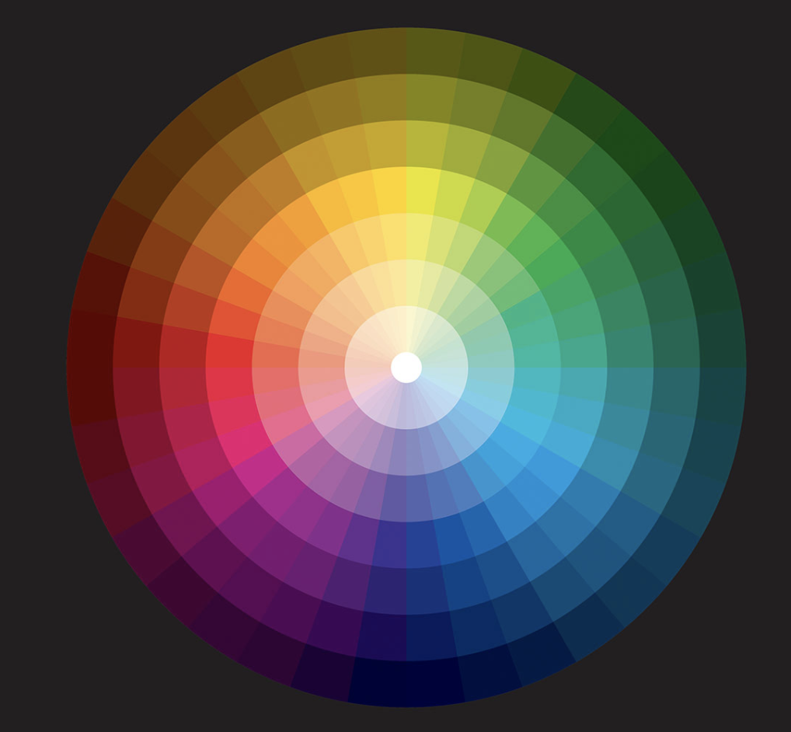
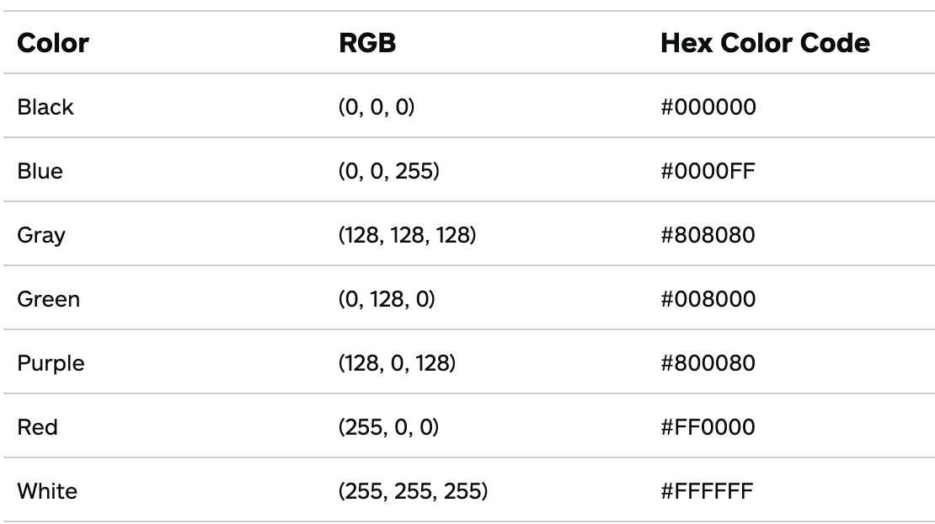
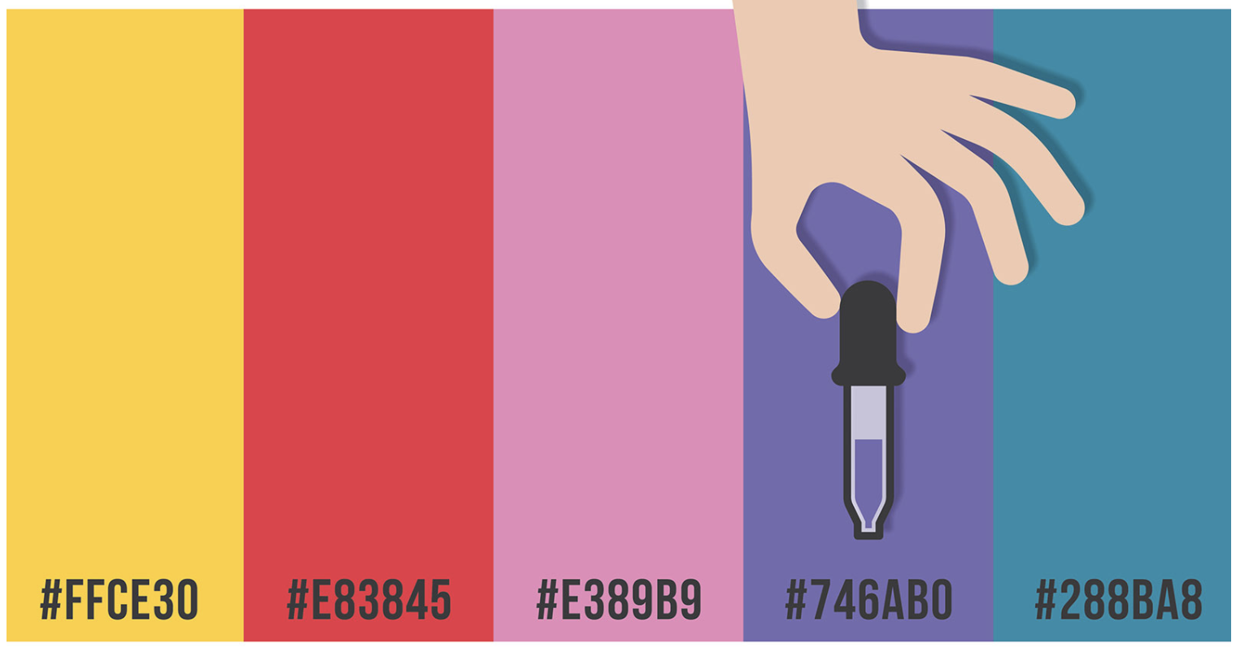
Hex Colour Code
A hex colour code is a 6-symbol code made of up to three 2-symbol elements
Each of the 2-symbol elements expresses a colour value from 0 to 255
You may be interested in these interesting videos and this website
Get Color Hex

Slide 26
Resource Materials
the Code Editor guide to get familiar with the Code Editor environment.
For more thorough JavaScript tutorials, see these Mozilla developer resources.
For an introduction to programming, with examples in JavaScript, see Eloquent JavaScript.
For suggestions on JavaScript coding style, see the Google JavaScript Style Guide.

Slide 27

Introduction to GitHub
https://github.com/

Slide 28

GITHUB USER INTERFACE

Slide 29




Thank You
Accra, Ghana
September, 2021
Notes:
It's free for non-commercial use!

